Slide 1


FIFA Player Information Management System
ERG 3010 Group 10 – Division Subgroup
Wenjing CAI 116010004
Yifan LAN 116010103
Zhihao XU 117010330
Erdi GAO 117010066
Yilei TU 117010251

Slide 2
1 Introduction
FIFA: International Football Association & Video Game
18000+ Players; 600+ Clubs
Football Player Information Demonstration & Management

Slide 3
2 Labor Division
Name | Student ID | Task Assignment
Wenjing CAI 蔡文婧 | 116010004 | Front-end Web Interface Design; Front- and Back-end Frame Construction
Yifan LAN 兰一帆 | 116010103 | Web Application by Flask; Back-end Functions Implementation; Front- and Back-end Frame Construction
Erdi GAO 高尔笛 | 117010330 | Web Application by Flask; Back-end Functions Implementation; Front-end Web Interface Design
Zhihao XU 徐志豪 | 117010066 | Data Collection and Preprocessing; Database Construction; Front-end Web Interface Design
Yilei TU 涂毅磊 | 117010251 | Schema Design; Data Analysis and Visualization; Machine Learning Implementation; PPT Preparation

Slide 4
3 Motivation & Goals
Integrate FIFA player information
Build well-informed database and beautiful display interface
Recommend similar players; Predict positions;
Better participate in online and offline football matches

Slide 5
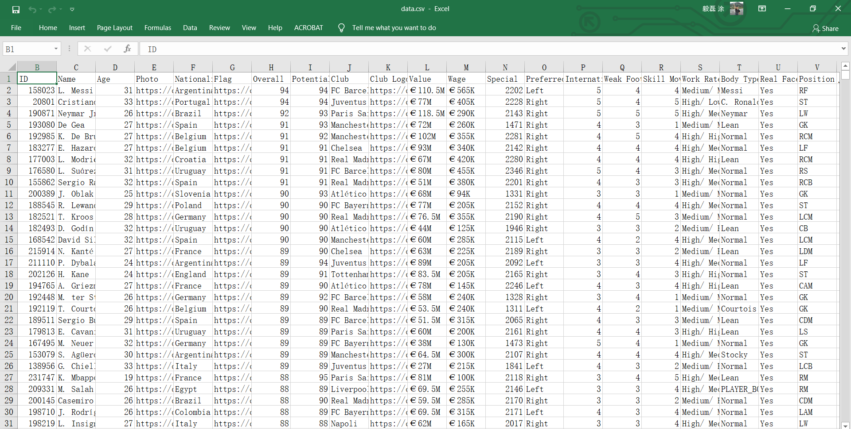
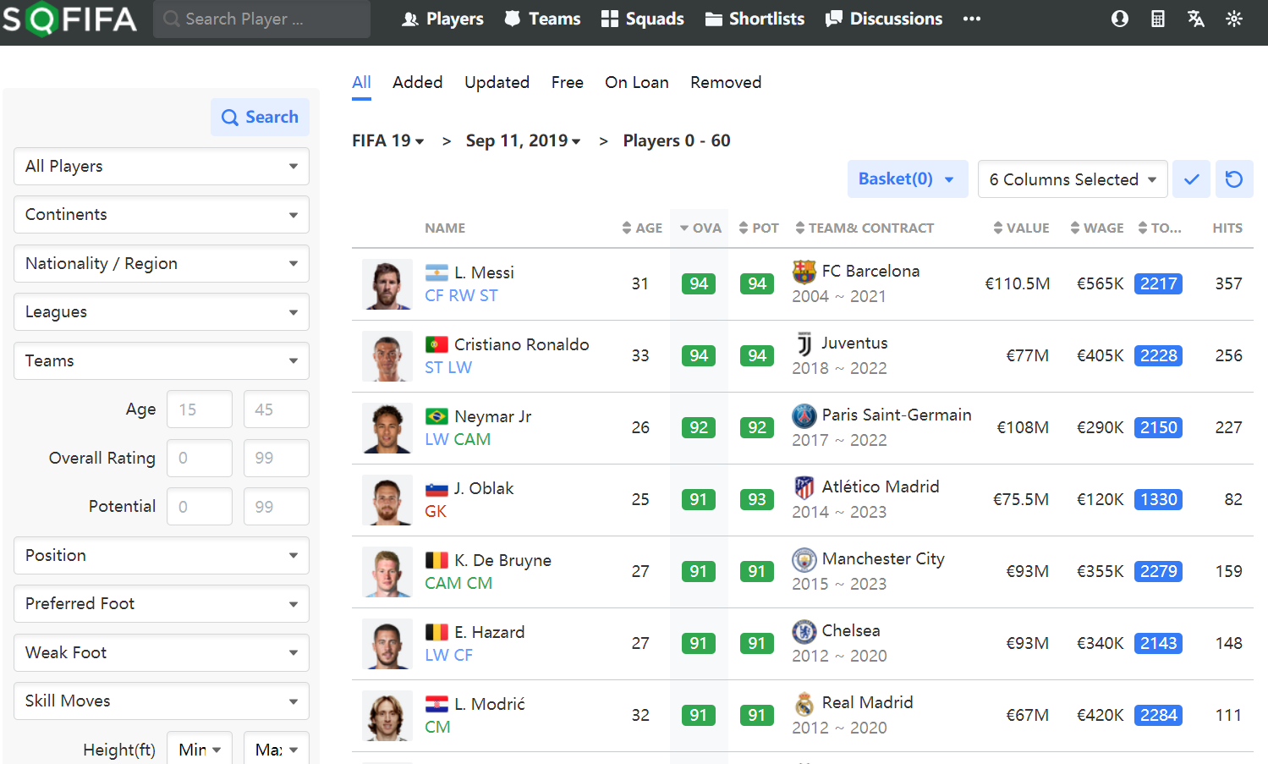
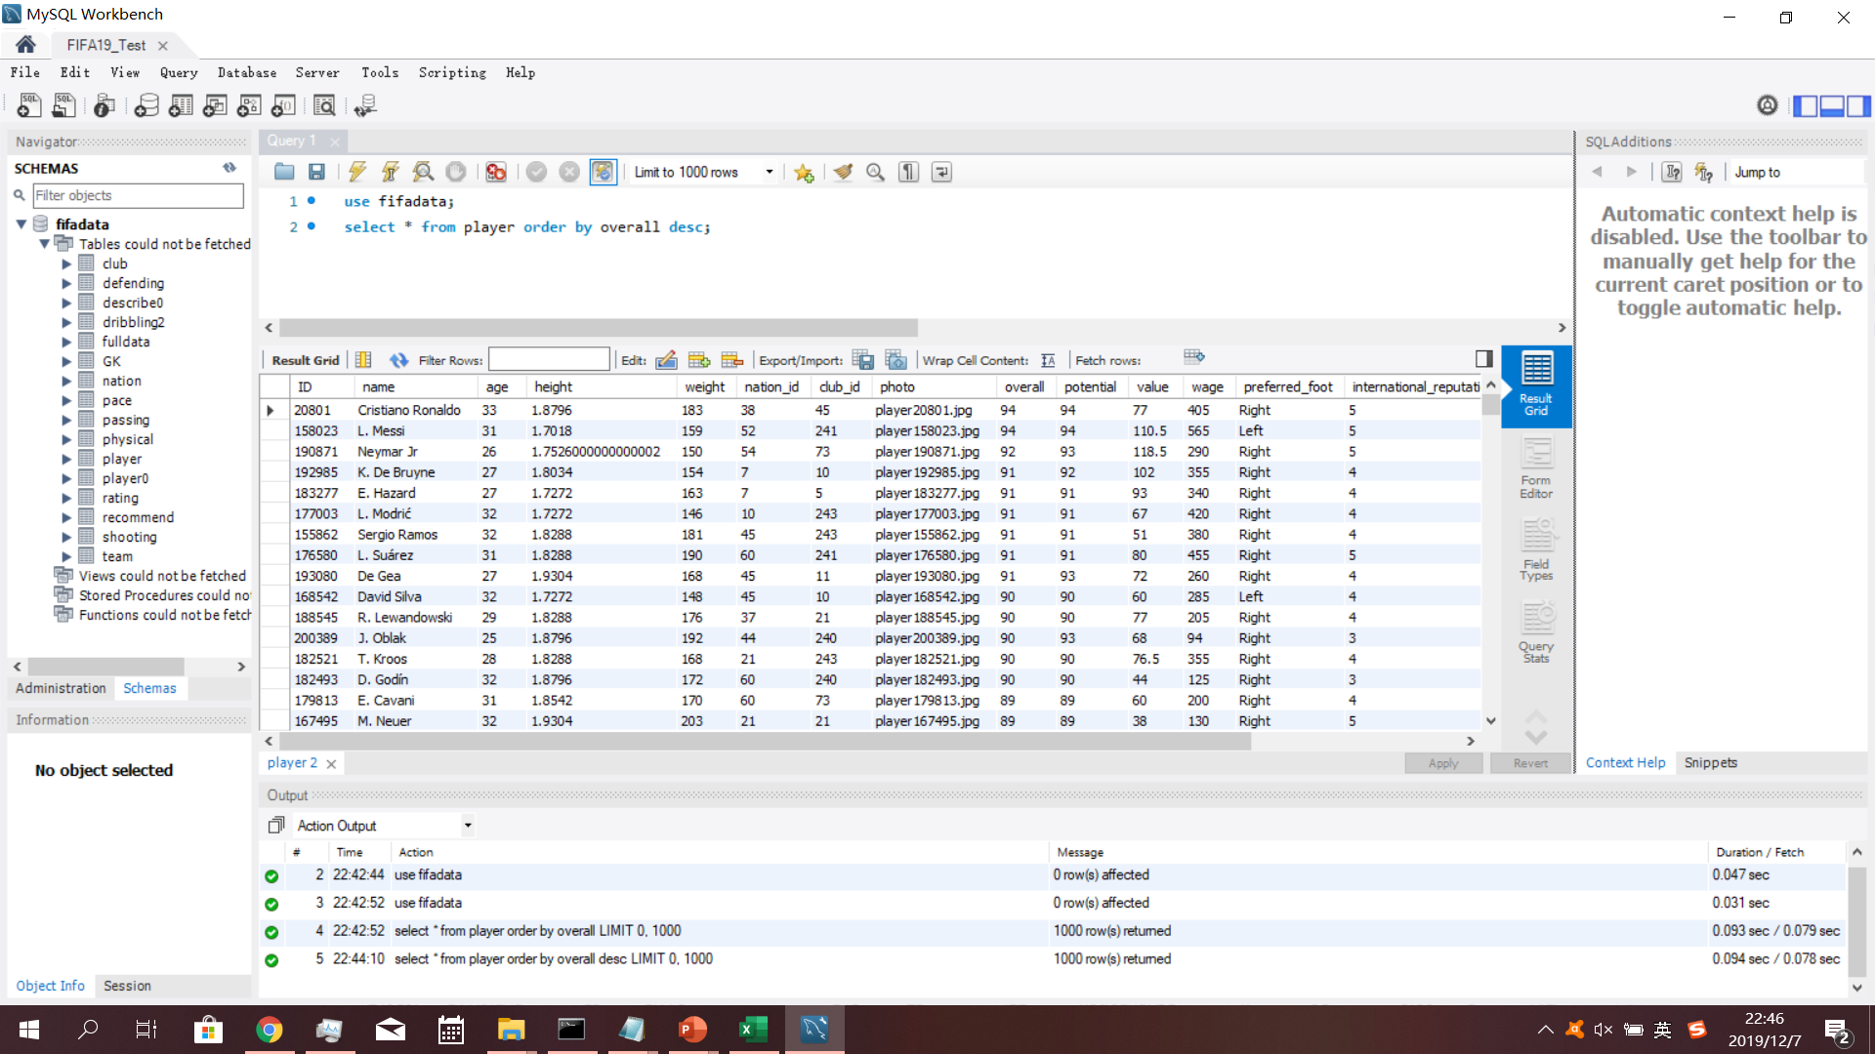
4 Materials & Data Source
Our data are crawled from https://sofifa.com/, which is a professional FIFA information website.

Slide 6
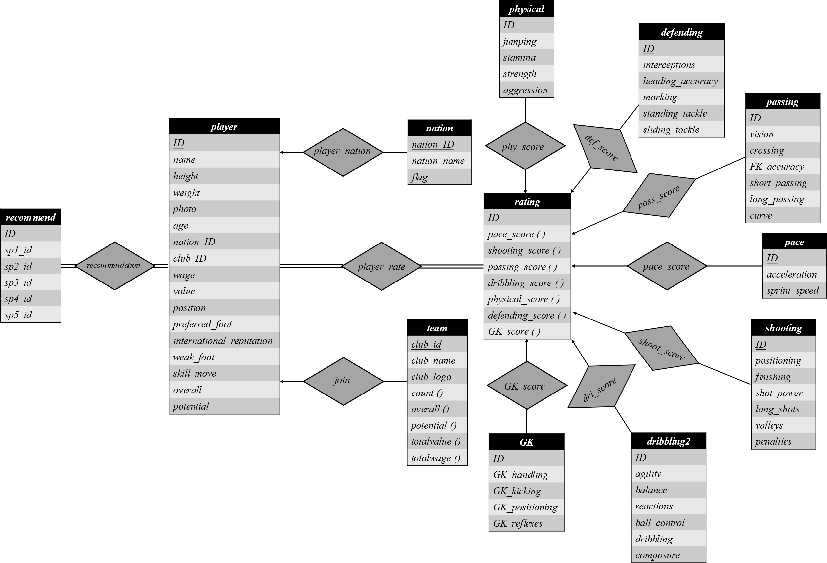
5 Database Schema

Slide 7
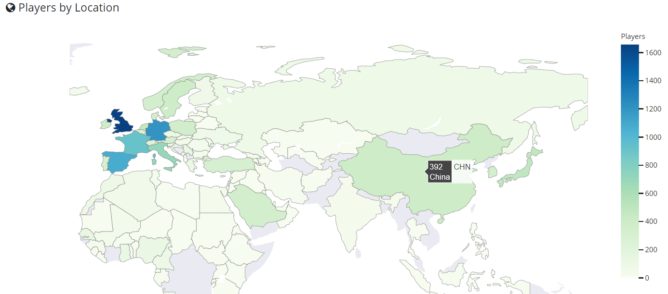
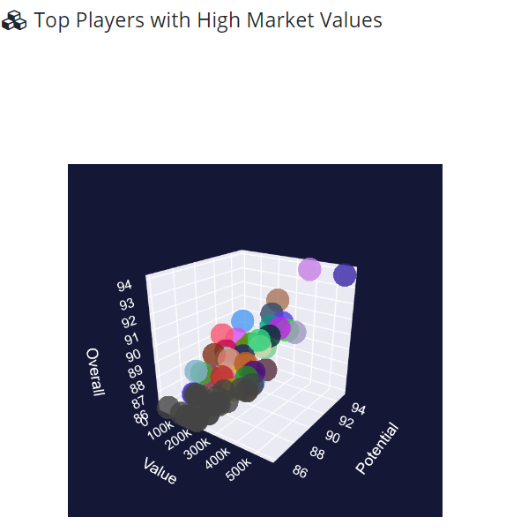
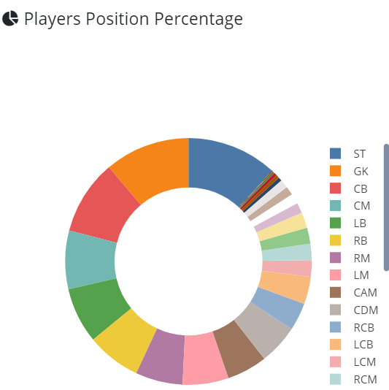
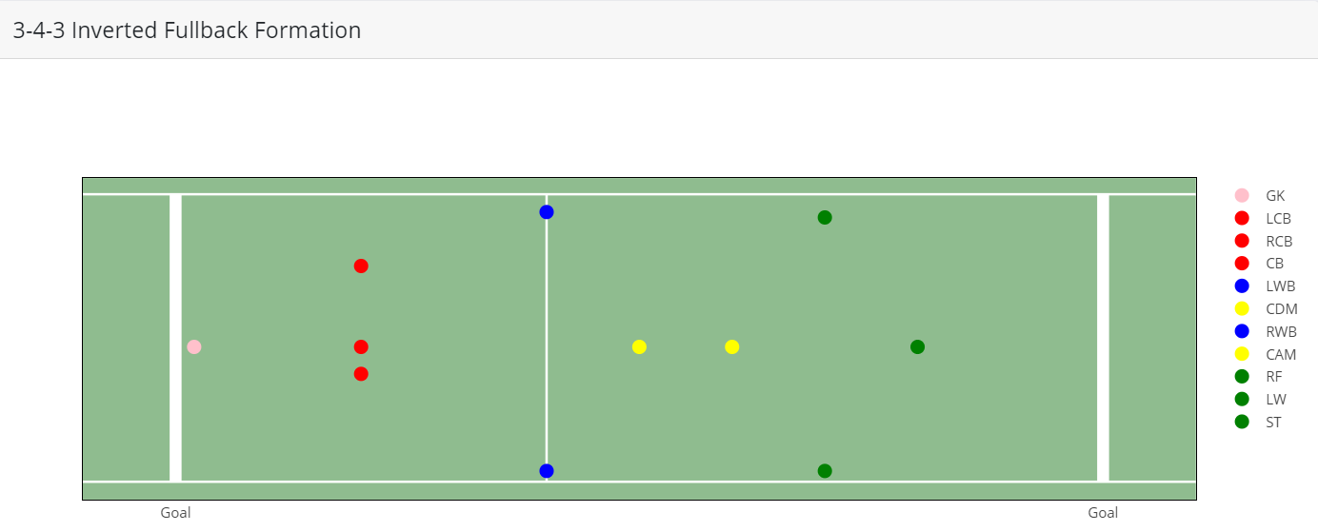
6 Statistics
World Map
Top Players
Percentages
Team Formation

Slide 8








7 Implementation
Front End
Overview
Back End

Slide 9
DEMO

Slide 10
8 Prospects
User Page: Sign up; Sign in; Profile
Favorites
Database Real-time Update

